Slide 1

A Major Project on Profile Hunter: A Smart Framework for Identifying Social Media Impersonation
Using Machine Learning by
1. B.Nikitha -21N81A6716
2. Venkatesh Sharma -21N81A6732
3. B.Lakshmi Charan Reddy -21N81A6750
4. K.Tarun Singh - 22N85A6708
Under the supervision of
Mrs .A. Sravanthi,MCA , M.Tech.
Assistant Professor
Department of CSE-Data Science Sphoorthy Engineering College (Affiliated to JNTUH Approved by AICTE)

Slide 2
CONTENT
ABSTRACT
INTRODUCTION
EXISTING SYSTEM
DISADVANTAGES
PROPOSED SYSTEM
ADVANTAGES
LITERATURE REVIEW
SYSTEM REQUIREMENTS
RESULTS
CONCLUSION

Slide 3
ABSTRACT
At present social network sites are part of the life for most of the people. Every day several people are creating their profiles on the social network platforms and they are interacting with others independent of the user’s location and time. The social network sites not only providing advantages to the users and also provide security issues to the users as well their information. To analyze, who are encouraging threats in social network we need to classify the social networks profiles of the users. From the classification, we can get the genuine profiles and fake profiles on the social networks. Traditionally, we have different classification methods for detecting the fake profiles on the social networks. But, we need to improve the accuracy rate of the fake profile detection in the social networks. In this paper we are proposing Machine learning and Natural language Processing (NLP) techniques to improve the accuracy rate of the fake profiles detection.
Key words:
Fake Profile Detection, Social Networks, Machine Learning, Natural Language Processing (NLP), Support Vector Machine (SVM),Naive bayes

Slide 4
INTRODUCTION
Social networking has end up a well-known recreation within the web at present, attracting hundreds of thousands of users, spending billions of minutes on such services. Online Social network (OSN) services variety from social interactions-based platforms similar to Face book or MySpace, to understanding dissemination-centric platforms reminiscent of twitter or Google Buzz, to Social interaction characteristic brought to present systems such as Flicker. The opposite hand, enhancing security concerns and protecting the OSN privateness still signify a most important bottleneck and viewed mission.

Slide 5
EXISTING SYSTEM
Current fake profile detection systems mainly use rule-based techniques and basic machine learning models, which rely on straightforward features like the number of friends or followers, how often a user posts, and how old the account is. These features are easy to collect but often fail to capture deeper, more complex behaviors. In some systems, network topology analysis is also used—this means studying how accounts are connected to each other. For example, fake profiles often show patterns like being linked to many random users or forming tight groups of interconnected fake accounts. While this adds some depth, it still has limits. A major issue with these systems is that they are mostly reactive—they respond after fake profiles become active. Because they rely on fixed rules and patterns, they struggle to adapt when attackers change their tactics. This makes it easier for new or smarter fake profiles to avoid detection. As a result, these systems often miss real threats or wrongly flag genuine users (false positives), highlighting the need for smarter, more flexible detection method.

Slide 6
PROBLEMS
They have low accuracy and often misclassify real users as fake (false positives).
Attackers can easily adapt their behavior to avoid detection.
They lack deep analysis of user content or behavior context.
Manual reviews are time-consuming and not scalable for large networks.
Most models are not adaptive to new or evolving fake profile strategies

Slide 7
PROPOSED SYSTEM
The proposed system uses a combination of Support Vector Machine (SVM) and Naive Bayes algorithms to improve accuracy and reliability. It begins by collecting user profile data such as account age, friend count, posting behavior, profile completeness, and username patterns. From this data, important features are extracted and used for classification. Naive Bayes is applied to handle textual and categorical data efficiently, while SVM is used for detecting more complex patterns based on numerical features. The results from both models are combined using a hybrid approach, such as weighted voting, to make the final decision. This system leverages the simplicity and speed of Naive Bayes along with the high precision of SVM, offering better detection of fake profiles by capturing both obvious and subtle indicators of suspicious behavior.

Slide 8
ADVANTAGES
In the proposed system, Profile information in online networks will also be static or dynamic. The details which can be supplied with the aid of the person on the time of profile creation is known as static knowledge, the place as the small print that are recounted with the aid of the system within the network is called dynamic knowledge.
In the proposed system, Social Networking offerings have facilitated identity theft and Impersonation attacks for serious as good as naïve attackers

Slide 9
LITERATURE REVIEW
Research Paper - 1
Title:Strangers intrusion detection-detecting spammers and fake profiles in social networks based on topology anomalies.
Authors:Michael Fire .
Date:January 2012.
Explanation: The SID (Strangers Intrusion Detection) project detects fake profiles and spammers in social networks by analyzing how users are connected.Fake users often show unusual connection patterns, like linking across many unrelated communities.The system looks for these network anomalies to identify suspicious behavior.It uses only the structure of the network, not personal data or messages

Slide 10
LITERATURE REVIEW
2. Research Paper - 2
Title:Identifying Fake Profiles in LinkedIn
Authors:Shalinda Adikari and Kaushik Dutta
Published:Pacific Asia Conference on Information Systems (PACIS) 2014
Explanation:The paper addresses the challenge of detecting fake profiles on LinkedIn, a professional networking platform. It proposes a methodology that utilizes publicly available profile data to identify inconsistencies indicative of fake accounts. The authors employ data mining techniques to analyze profile attributes such as job titles, company names, and connections. The approach aims to enhance the trustworthiness of LinkedIn by automating the detection of fraudulent profiles. This research contributes to the field by providing a scalable solution to a prevalent issue in online professional networks.

Slide 11
LITERATURE REVIEW
3. Research paper -3
Title: Malicious Users’ Circle Detection in Social Network Based on Spatio-Temporal Co-Occurrence
Authors: Z. Halim, M. Gul, N. ul Hassan, R. Baig, S. Rehman, F. Naz
Published: International Conference on Computer Networks and Information Technology (ICCNIT),July 2011
Summary :The paper proposes a method to detect malicious users in social networks by analyzing spatio-temporal co-occurrence patterns. It focuses on identifying suspicious user groups based on their location and activity timing. The approach utilizes data mining techniques to analyze user behavior and interactions. The method aims to enhance security by identifying potential threats through pattern recognition. This research contributes to the field by providing a novel approach to detecting malicious activities in social networks.

Slide 12
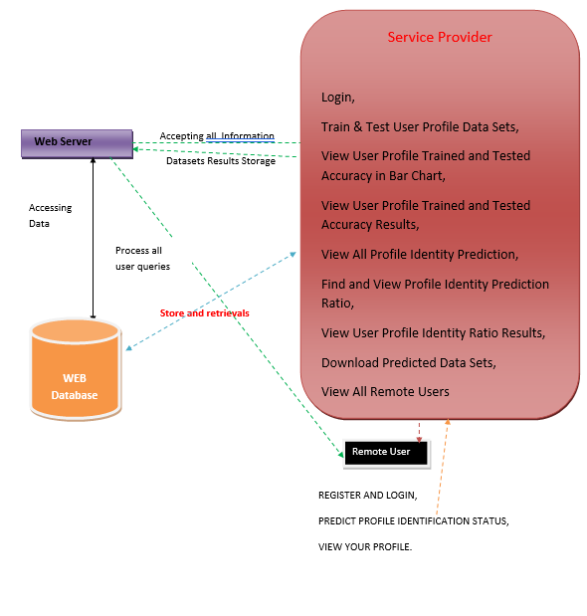
SYSTEM ARCHITECTURE

Slide 13
EXPLANATION
The diagram illustrates a system for fake profile detection involving three main components: the Web Server, the Web Database, and two user roles — the Service Provider and the Remote User. The web server handles data flow, processing all user queries and storing results in the web database. The Service Provider has advanced capabilities, including logging in, training and testing user profile datasets, viewing accuracy in charts, analyzing prediction ratios, downloading predicted data, and viewing all remote users. The Remote User, on the other hand, can register, log in, check their profile identification status, and view their profile. The system enables data to be accepted, processed, stored, and retrieved efficiently, supporting real-time identity prediction and monitoring of fake profiles.

Slide 14
SYSTEM REQUIREMENTS
Hardware System Configuration
Processor - Pentium –IV RAM - 4 GB (min)
Hard Disk - 20 GB
Key Board - Standard Windows
Keyboard Mouse - Two or Three Button Mouse
Monitor – SVGA
Software System Requirements
Operating system : Windows 7 Ultimate.
Coding Language : Python.
Front-End : Python.
Back-End : Django-ORM
Designing : Html ,css , javascript.
Data Base : MySQL (WAMP Server).

Slide 15
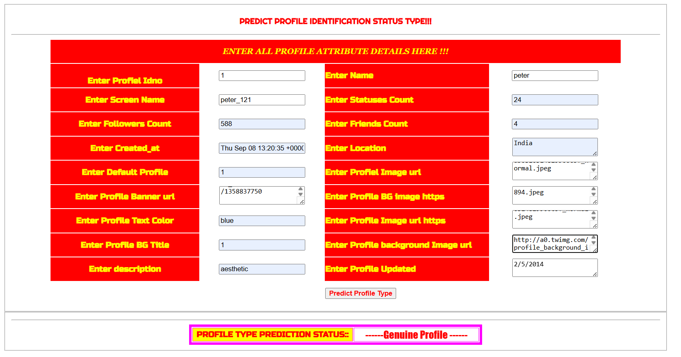
RESULTS

Slide 16
CONCLUSION
We proposed machine learning algorithms along with natural language processing techniques. By using these techniques, we can easily detect the fake profiles from the social network sites. we took the Face book Data set to identify the fake profiles. The NLP pre-processing techniques are used to analyze the dataset and machine learning algorithm such as SVM and Naïve Bayes are used to classify the profiles. These learning algorithms are improved the detection accuracy rate .

Slide 17
QUERIES?

Slide 18
THANK YOU

